Slide 1
Ariel Anati
Character
Growth
Teaching
Motivation
Challenge
Trust
Team Work
Intellectualism

Slide 2


Slide 3
Fernando Atias
Family
Passion
Tolerance
Self Esteem
Hard work
Care
Support
Reflection

Slide 5
Ayo Awolope
INNER PEACE
FAMILY
WEALTH
INTEGRITY
COMPETENCE
BLISS
CONFIDENCE
CALM

Slide 7
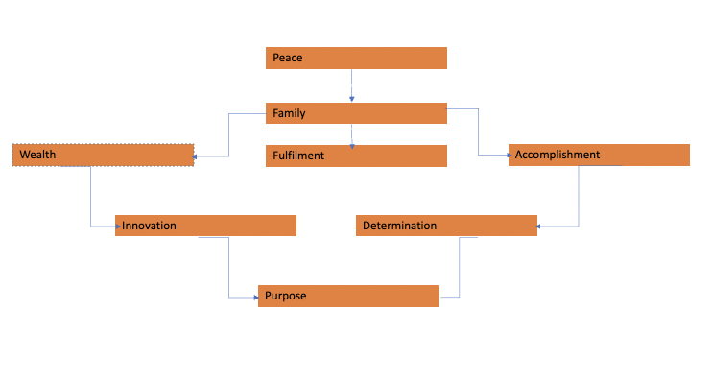
Oladapo Ayelowo

Slide 9
Ahmad Bilal
Contentment
Family
Fulfillment
Kindness
Tolerance
Health
Faith

Slide 11
Kory Borenkoff
Unconditional Love
Ambition
Heart
Dreaming
Persistence
Affection
Health
Playfulness

Slide 13
Ahmed Gamal
Achievement
Family
Responsibility
Learnings
Loyalty
Humor
Thinking
Faith

Slide 15
Max Gingell

Slide 17
Rahul Goel
Greatness
Happiness
Inner Peace
Adventure
Excellence
Social Impact
Family & Friends
Strong Work Ethics
Innovation
Ambition

Slide 19
Chuen Gooi
Contentment
Family
Charity
Discovery
Dependability/Reliability
Wealth
Commitment
Integrity

Slide 21
Christopher Haroun

Slide 23
Elkhan Hasanov
Comfort
Wealth
Family
Success
Wellbeing
Appreciation
Make a Difference
Do the right thing
Diligence

Slide 25
Namita Kain
Happiness
Freedom
Maximize Income
Appreciated
Make a Difference
Independence
Do What’s Right
Learning

Slide 27
Seita Kinoshita
Comfort
Tranquility
Balance
Optimism
Autonomy
Justice
Professionalism
Responsibility

Slide 29
Niki Leung
Inner Harmony
Unity
Help People
Energy
Compassion
Understanding
Challenge
Self Awareness

Slide 31
Sophia Lin
Faith
Greatness
Reliability
Achievement
Motivation
Productivity
Passion
Trust

Slide 33
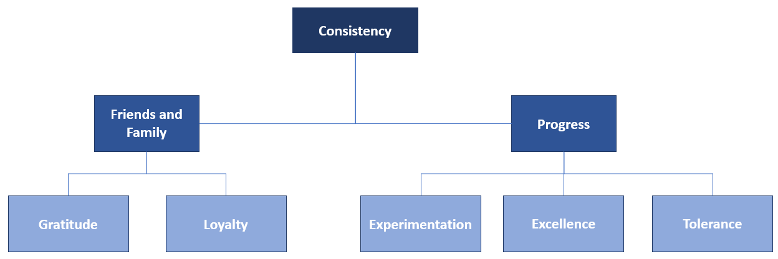
Javier Marquez

Slide 35
Danny Mekic
Serenity
Comfort
Respect
Family
Make a Difference
Caring
Financial Security
Excellence

Slide 37
Sean Nasiri
Fulfillment
Significance
Autonomy
Stimulate
Intellectual
Prescence
Patience
Industries

Slide 39
Suzanne Ngan
Joy
Authenticity
Freedom
Integrity
Feel Good
Golden Rule
Listening
Empathy

Slide 41
Gabriela Poplawska
Integrity
Self-Awareness
Honesty
Independence
Family
Humility
Ethical
Making a Difference

Slide 43
Dardan Pulatani
Family
Wealth
Legacy
Ambition
Reliability
Integrity
Uniqueness
Hard work

Slide 45
Juan Quinones
Growth
Legacy
Family
Outcome
Gratitude
Excellence
Knowledge
Discipline

Slide 47
Rob Reeder
Fulfillment
Serenity
Growth
Gratitude
Humility
Hard work
Presence
Integrity

Slide 49
Harsh Sahu
Peace
Wealth
Family
Duty
Health
Culture
Integrity
Impact
Self-Awareness
Freedom
Innovative
Honor
Excitement

Slide 51
Ivan Sobo
Honor
Unconditional Love
Satisfaction
Care
Trust
Generosity
Inclusion
Understanding

Slide 53
Mykhailo Stetsiuk
Feel Good
Opportunity
Equity
Courage
Enthusiasm
Security
Edge
Creativity
Notes:
不想洗了

Slide 55
Jacqueline Talledo
Impact
Fulfillment
Family
Excellence
Trust
Innovation
Integrity
Growth

Slide 57
Alejandro Torres
Serenity
Fun
Friends & Family
Logic
Teaching
Challenge
Respect
Empowerment

Slide 59
Orlando Andrade
Integrity
Respect
Trust
Tolerance
Commitment
Equity
Perseverance
Consistency

Slide 61
Ana Zuzul
Happiness
Love
Spirituality
Logic
Freedom
Make a Difference
Obedience
Fun

